Slide 1
Project Progress Review #2
(Customer Requirement Specifications)
Project Title: Detection of Events and Emerging Themes
from Social Media Streams
Project ID: PW19COP01
Project Guide: Prof C.O Prakash
Project Team : Vaishnavi Rao (01FB15ECS334)
Varsha R (01FB15ECS337)
Team name: PES_334_337_000

Slide 2
Project Abstract and Scope
The micro-blogging platform, Twitter, has opened people up to an entirely new world of information-gathering and news-sharing, including but not limited to detailing everyday events and activities of the users, the “Tweeple”.
These Tweets are, for the most part, uncategorised and lack relevance because of this. Hashtags used and made up by the tweeple are the only forms of categorisation available right now.
Detecting events and trending topics from these hashtags in a way so as to make a user’s feed more enriching and optimal is the primary goal of this project.
A holistic comparison of the different methods in which to detect these events and trending topics is also included in the ambit of this project.

Slide 3
Further Literature Survey
Tweet Analysis for Real-Time Event Detection and Earthquake Reporting System Development Ekta, Paahuni Khandelwal, Priya Bundela, Richa Dewan
This paper attempts to do an analysis/monitoring of tweets in order to be able to detect earthquakes in real time.
The approach taken is one of the classification of tweets by putting them through a Naive Bayes classifier, based on features as keywords, sentiment, number of words, and context. Post this classification, a probabilistic value is associated with the tweets under consideration which signifies the occurrence or non-occurrence of the earthquake.
The study hopes to further the results obtained to create an application to alert users of the disaster based on their geo-location.

Slide 4
User Characteristics
The haphazard nature of tweets can make a timeline quite messy.
Twitter also happens to be one of the most important sources of news for people where they hear or read about a particular event first.
In the face of this, we propose a solution where the user’s timeline also reflects trending topics based on national emergency and other filters among other trending topics.
This not only pushes events of national importance to the top of the user’s timeline, it also filters out certain other trending topics that are given importance by media organisations in which the user might not be all that interested.

Slide 5
Dependencies / Assumptions / Risks
Dependencies:
The project will depend on the efficient functioning of Twitter minus any crashes on any given day to be able to conduct real time analysis smoothly in the long run.
A proper, working internet connection that keeps the end user connected with their surroundings in order to access Twitter easily.
Risks:
Misinformation given by people is the biggest threat that the project faces.
Additionally, false positives generated by the model can pose a problem that will cause confusion among the users.
Assumptions:
Each Twitter user is assumed to be a sensor, that detects a target event and makes an observation. This observation is the actual tweet.
The tweets are given time values as well as a location (latitudinal and longitudinal coordinates).

Slide 6
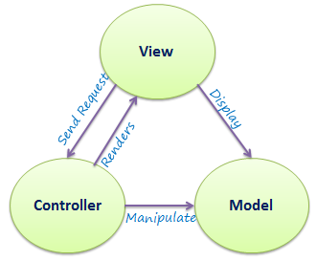
System Architecture
We plan to follow the MVC system architecture
Model: we will have a business unit with basically our fixed twitter training data. The twitter live data fetched from the website will be our testing data, both stored in our database.
View: we do require a frontend view to display to the users. Although there isn’t much interaction with the interface, it is required to hide the implementation from the end user and for simple display of resultant tweets
Controller: since we have number of algorithms that are being tested on the tweets, a voting mechanism is adopted at the backend and the best algorithm is chosen to display the outputs to the user interface.

Slide 7
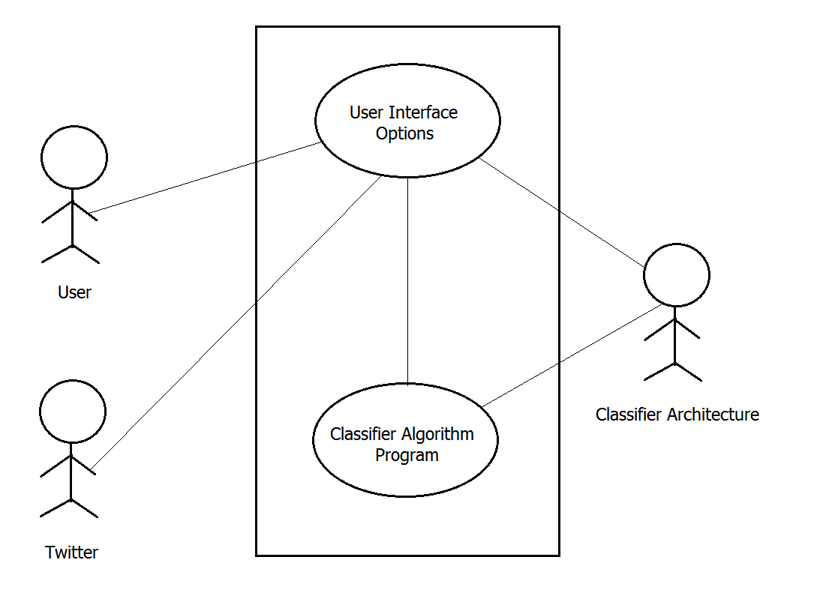
UI/ Use Case

Slide 8
Modules
Tweets of that particular day will be displayed. This will be fetched directly from twitter.com from current ‘yyyy:mm:dd 00:00:00’ timestamp till the current time ‘yyyy:mm:dd hh:mm:ss’
on clicking on the trending topic, most relevant tweets from the residing country (India) with respect to natural disasters, health hazards (epidemic and breakouts), terror attacks and severe weather forecasts will be displayed. These will be the only 4 categories.
If no relevant trending tweets were found that belong to any of these categories, the tweets will be displayed as usual.
We will plan on adding a default sorting of the tweets based on the likes/shares of the tweets.

Slide 9
Technologies Used
Python - An easy to use language with built-in modules for any operation. All backend operations can be carried out easily
Jupyter notebook - for implementing main algorithm and testing immediately on dataset.
Bootstrap - open source framework for front-end development. Simple and easy to use designs available. Front end will be only for display purposes with minimal functionality
Python modules like numpy, pandas, scikit-learn, keras and tensorflow to implement different algorithms for trending topic prediction.

Slide 10
Thank You

